Slide 1
A presentation on online module that focuses on phishing attacks :
Explain how to recognize phishing emails and fake websites. Social engineering tactics used by attackers, Best practices and tips to avoid falling victim of phishing attack. Real-world examples and interactive quizzes

Slide 2
What is phishing?
Phishing is a form of social engineering and a scam where an attackers deceives victims into revealing or giving out sensitive information or installing malware such as viruses, worms, adware, or ransomware on victim’s systems.
Notes:
Prepared by John Raymond Huzey

Slide 3
Learn to spot phishing emails
Check spellings and grammatical expressions
Check emails properly before proceeding(especially the domain names)
Requests for sensitive information
Unsolicited attachments or links

Slide 4
How to identify phishing email
STOP Method
Is the email….
Suspicious?
Telling you to click?
Offering something amazing?
Pushing you to act quickly?

Slide 5
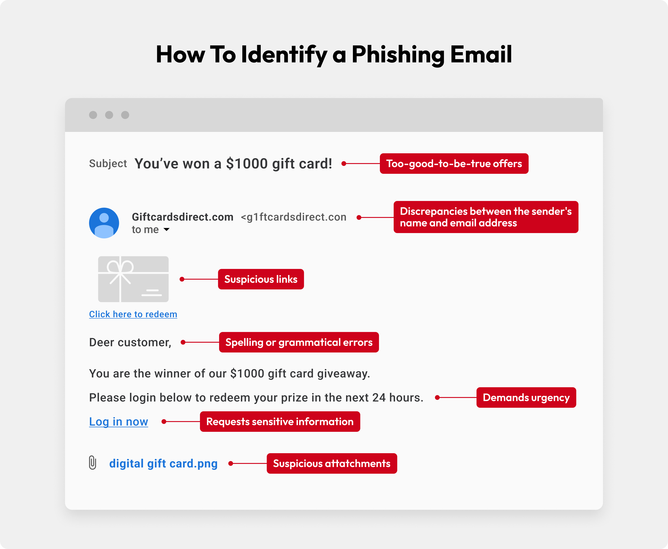

Slide 6
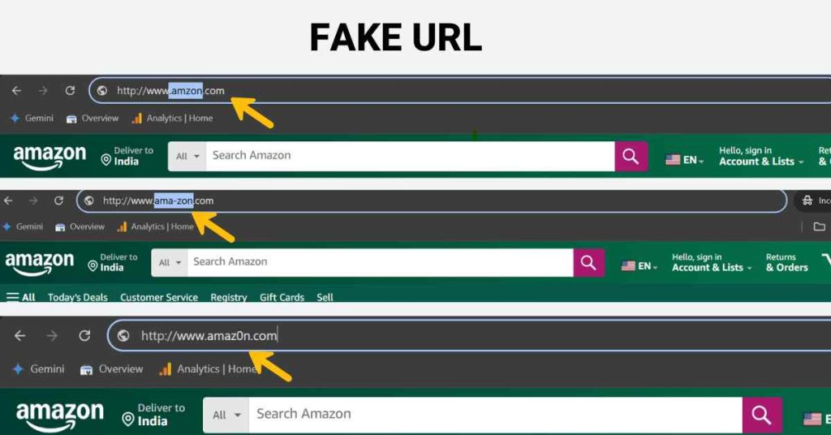

Slide 7
Social Engineering tactics used by attackers
Phishing : Attacker use deceptive emails ,websites and text messages to steal sensitive personal or organizational information from unsuspecting victims.
Spear Phishing: Attacker carry out targeted attacks against individual or organization.
Baiting : The attacker usually promises the victim a reward in return for sensitive information or knowledge of its whereabouts. example Giving out of malware-infected USB
Malware: Attacker sends malicious software , and trick victims with an urgently worded message into installing the malware on their device(s)
Pretexting: This involves the perpetrator assuming a false identity to trick victims into giving up information.
Tailgating : This targets an individual who can give a criminal physical access to a secure building or area.
Vishing : Attacker leave urgent voicemails to convince victims they must act quickly to protect themselves from arrest or another risk.
Water-Holing: Technique use to infect a website and its visitors with malware.

Slide 8
How do we stop getting phished?
Don’t respond to phishing (suspicious) emails
If things look “phishy”, verify with the sender through a different medium
Avoid sharing personal information to emails you are unsure .(Never give out personal information)
Be mindful of emails that require your urgent attention in providing information.
Think before you click
Beware of pop-ups
When you are in doubt, throw it out. You are the last line of defense.

Slide 9
Phishing awareness training with Randomly Shuffled quiz answer options
Prepared by John Raymond Huzey
START
Notes:
Prepared by John Raymond Huzey

Slide 10
Don’t delete this slide, keep this hidden. This allows our interactive code to run properly!

Slide 11

1. Which of the following is common red flag indicating an email might be a phishing attempt?
A message from your known colleague
A generic greeting like “Dear Customer”
An email containing only text without links
A personalized salutation using your full name
NEXT
Notes:
Prepared by John Raymond Huzey

Slide 12
2. What is the most secure approach to analyze a suspicious executable email attachment?
Scan it after opening
Use an isolated virtual machine or sandbox environment
Open it directly on your work computer
Upload it to a public forum for advice
NEXT
Notes:
Prepared by John Raymond Huzey

Slide 13
3. Which indicator might suggest a website is part of a phishing scam?
Legitimate company branding
Misspelling in the domain name
Use of a verified security seal
Well-structured navigation menus
NEXT
Notes:
Prepared by John Raymond Huzey

Slide 14
4. What is smishing?
Phishing through social media
Phishing via SMS or text messages
Phishing via email attachments
Phishing via voice calls
NEXT
Notes:
Prepared by John Raymond Huzey

Slide 15
5. When you receive an unsolicited email with a link, what is the safest first action?
Delete the email without checking further
Reply asking the sender to verify their identity
Hover over the link to view the actual URL
Click the link to see the content
NEXT
Notes:
Prepared by John Raymond Huzey

Slide 16
6. What is spear phishing?
A general email sent to many recipients
Malware downloaded from compromised websites
A targeted phishing attack using personal information
Phishing conducted via phone calls
NEXT
Notes:
Prepared by John Raymond Huzey

Slide 17
7. What is the purpose of sandboxing suspicious email attachments?
Send attachments to colleagues
Block attachments permanently
Execute code in a controlled environment
Increase email load speed
NEXT
Notes:
Prepared by John Raymond Huzey

Slide 18
8. What is a telltale sign of a suspicious email attachment?
A document with a .docx extension from a known colleague
An image file with a .jpg extension
A PDF file from a trusted vendor
An unexpected .exe or .scr file
NEXT
Notes:
Prepared by John Raymond Huzey

Slide 19
9. Which of the following is a secure practice when creating passwords?
Using “password123” for easy recall
Writing passwords on a sticky note
Reusing old passwords across accounts
Including symbols, numbers, and uppercase letters
NEXT
Notes:
Prepared by John Raymond Huzey

Slide 20
10. Type practice helps protect against phishing by strengthening account security?
Turning off automatic updates
Enabling two-factor authentication
Using the same password on multiple sites
Sharing passwords with trusted friends
NEXT
Notes:
Prepared by John Raymond Huzey

Slide 21
11. How can you verify that a website uses a secure connection?
The page has high-resolution images
Brower shows a padlock icon and “https://”
URL begins with “ http://”
It loads faster than other sites
NEXT
Notes:
Prepared by John Raymond Huzey

Slide 22
12. Which method provides the strongest protection against account compromise?
SMS-based two-factor authentication
Hardware security keys
Complex passwords without two-factor authentication
Email-based one-time codes
NEXT
Notes:
Prepared by John Raymond Huzey

Slide 23
13. Why is it dangerous to click on shortened URLs from unknown sources?
They always lead to government websites
They hide the final destination
They are always safe
They cannot contain malware
NEXT
Notes:
Prepared by John Raymond Huzey

Slide 24
14. How should you report a suspected phishing email within an organization?
Ignore it without alerting anyone
Forward it to the IT or security team
Post about it on a public forum
Reply to the sender asking for their identity
NEXT
Notes:
Prepared by John Raymond Huzey

Slide 25
15. What is the risk of downloading free software from unverified third-party sites?
It often contains built-in antivirus tools
It might install adware or malware
It always improves systems performance
It never affects your privacy
NEXT
Notes:
Prepared by John Raymond Huzey

Slide 26
Thank you for taking part in this quiz!
EXIT
Notes:
Prepared by John Raymond Huzey

